Slide 1
Ethererum Close price prediction DATS6313 time series analysis & modelling– Final Term Project Professor : Reza Jafari
Presented by: Sagar Tripathi

Slide 2
Table Of Content
Introduction
Description of Dataset
Stationarity
Time Series Decomposition
Holt-Winters method
Feature Selection
Base-Models
Multi-Linear Regression
ARMA and ARIMA model
Diagnostic Analysis
Final Model selection
Forecast function
h-step ahead Predictions
Summary and conclusion
Appendix
References

Slide 3
Introduction
We want to accurately anticipate the Ethereum closing price by considering a variety of factors that influence its value. We want to understand and uncover Hourly trends in the Ethereum market in the first phase of our inquiry, as well as acquire insight into the best characteristics surrounding Ethereum price.

Slide 4
Description of Dataset
The Data set used in this project is ETH_1H.csv contains all the 1-hour historical data from 2020-04-16 00:00:00 - 2016-05-09 13:00:00, this dataset contains 7 columns including Unix Timestamp, dates, opening, high, low, closing, and volume and 34497 rows/Observations

Slide 5
Pre-Processing
The target variable is ‘Close’ which refers to the closing price of Ethereum in USD
Dataset has no null or missing values
Dataset has 7 columns from which we are calculating
Market Cap
Volatility
Cumulative Price
Checking missing values
Selecting Target for prediction

Slide 6
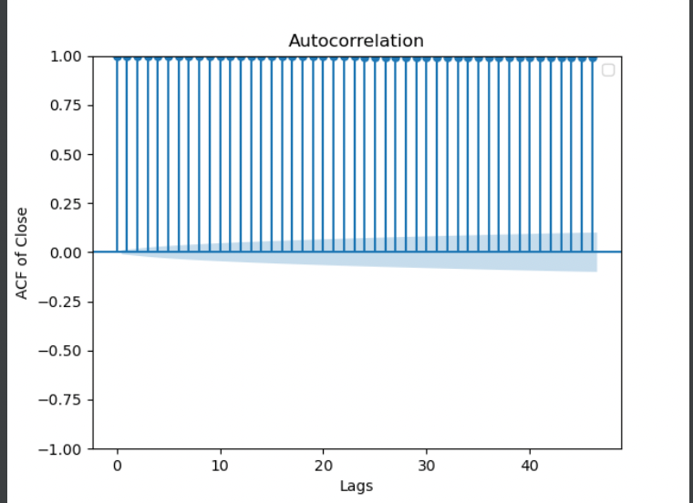
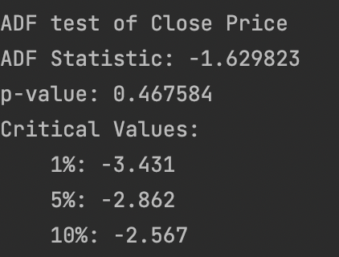
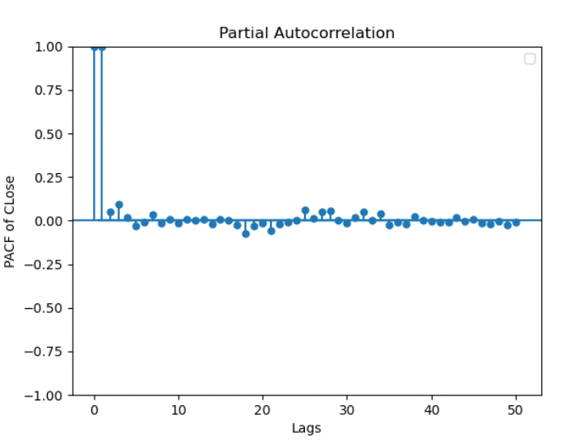
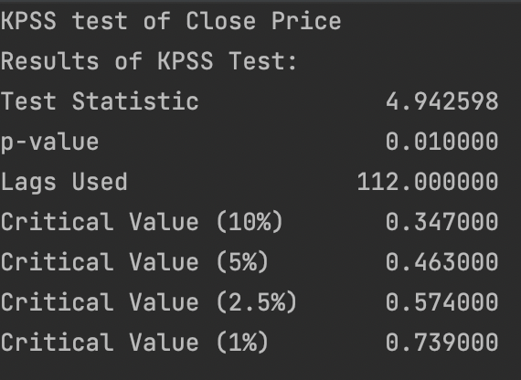
Stationarity
This is the ACF/PACF plots of raw data
ADF test results:
KPSS test results:

Slide 7
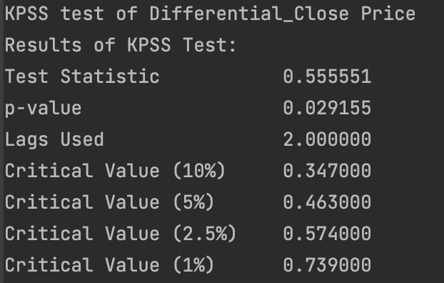
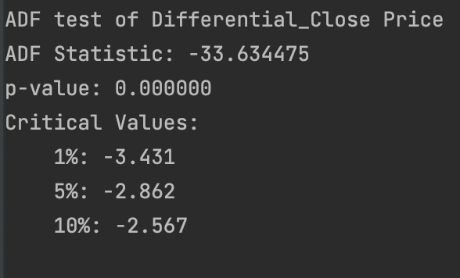
ADF test results: KPSS test results:
Stationary test on Log transform and 1st order differenced data:
From ADF test results, the data is stationary
From KPSS test results, the data is stationary

Slide 8
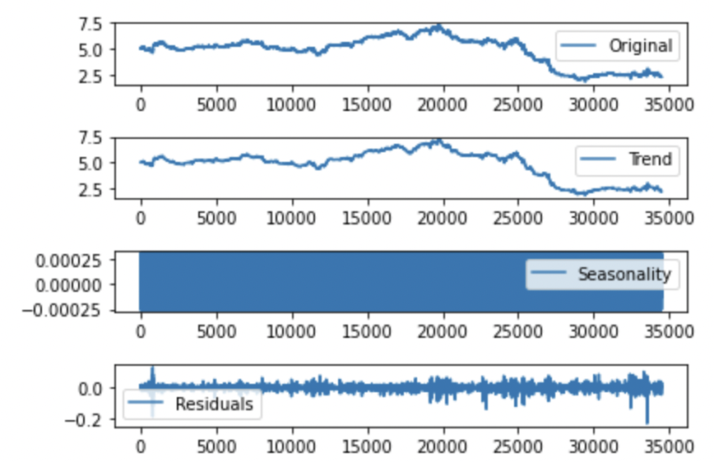
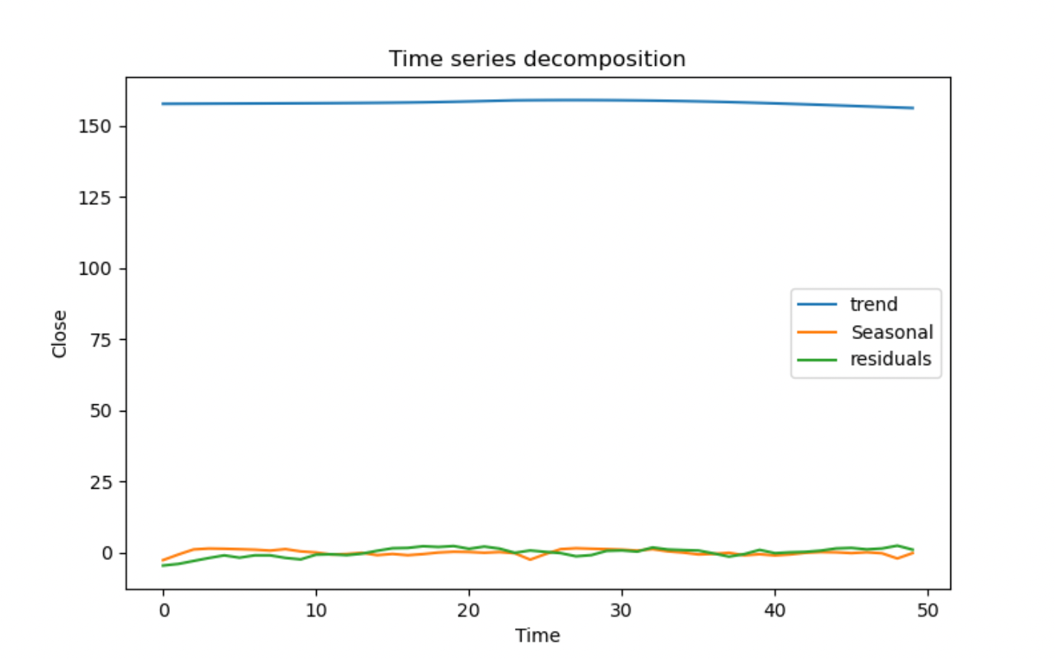
Time Series Decomposition

Slide 9
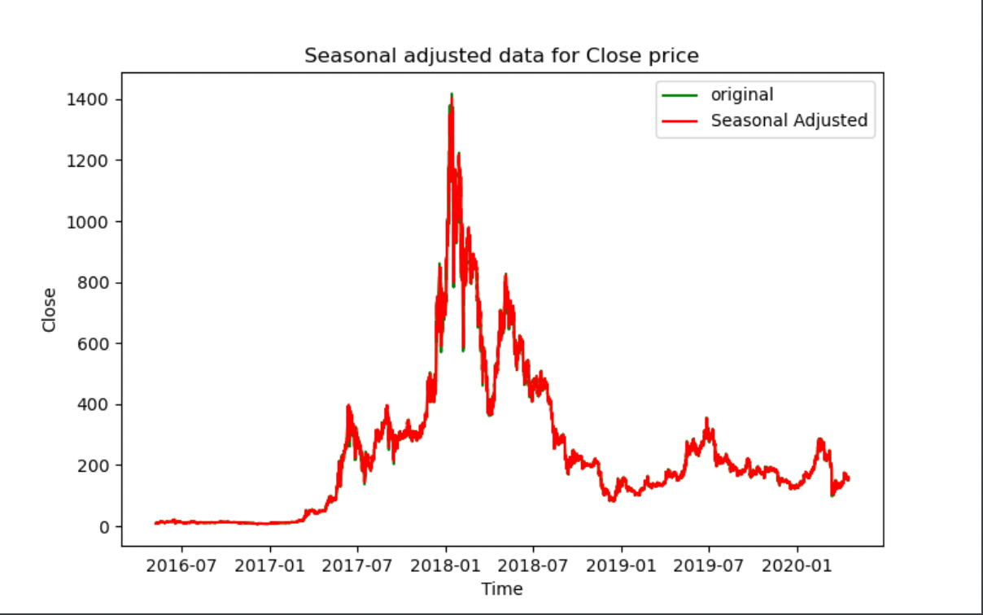
Time Series Decomposition
We can observe that there is a very high trend in the raw data since the strength of the trend is very high at around ~ 0.99
There is low seasonality in the raw data since the strength of the seasonality is low at around ~0.249.

Slide 10
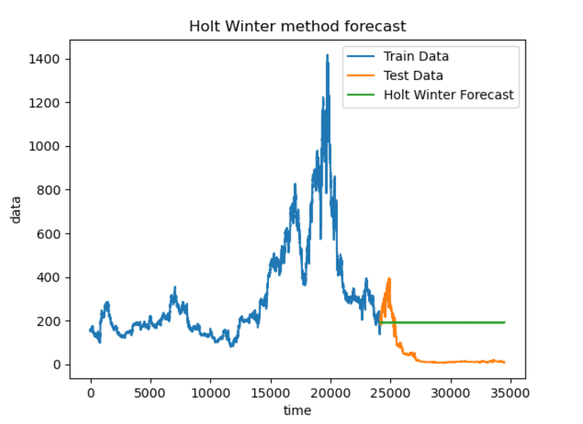
Holt-Winters method
We can observe that the Holt winter method did not give good predictions as it is not following the test results.

Slide 11
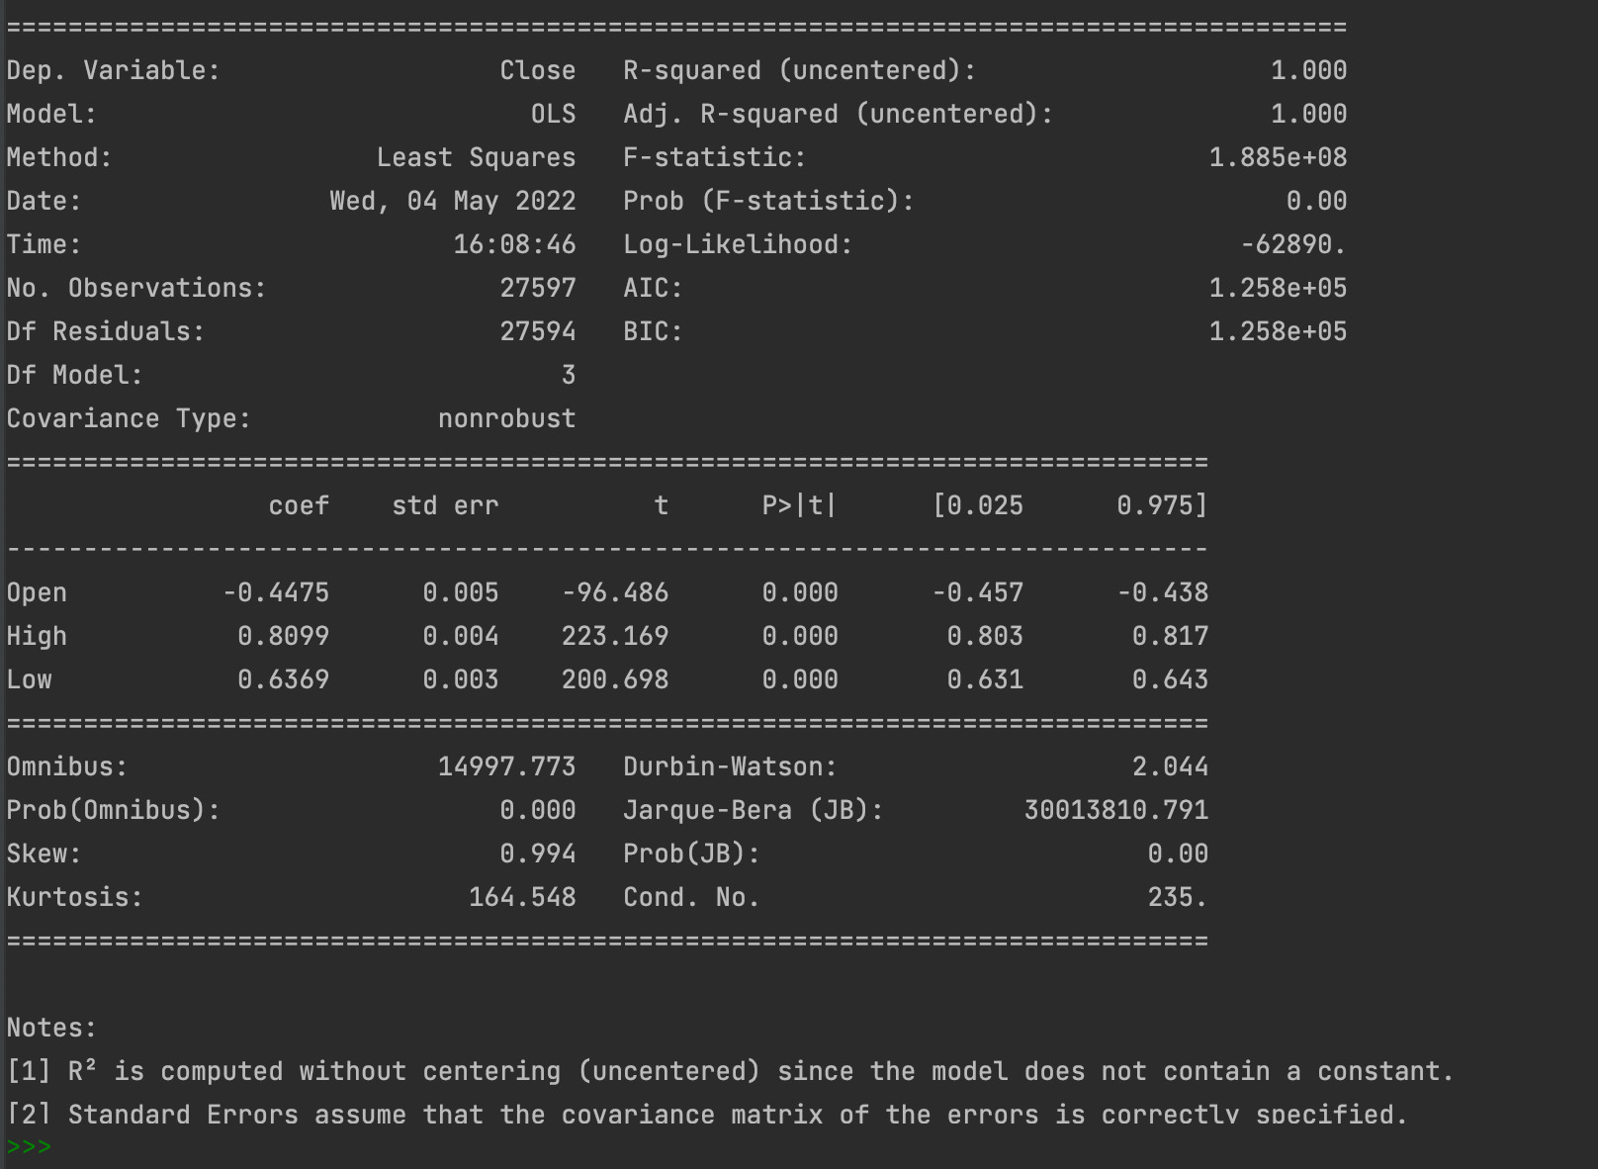
Feature Selection
On the right, we can observe that Volume has a p-value of 0.002, which is high so we can remove this variable and run the regression again.
The final model of OLS regression

Slide 12
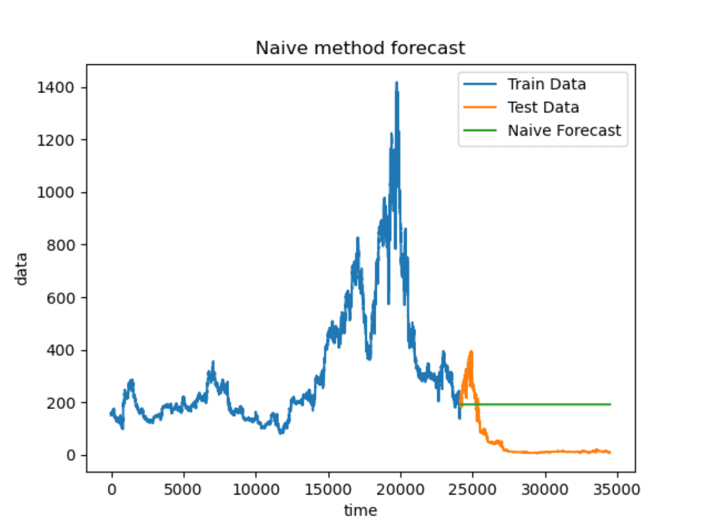
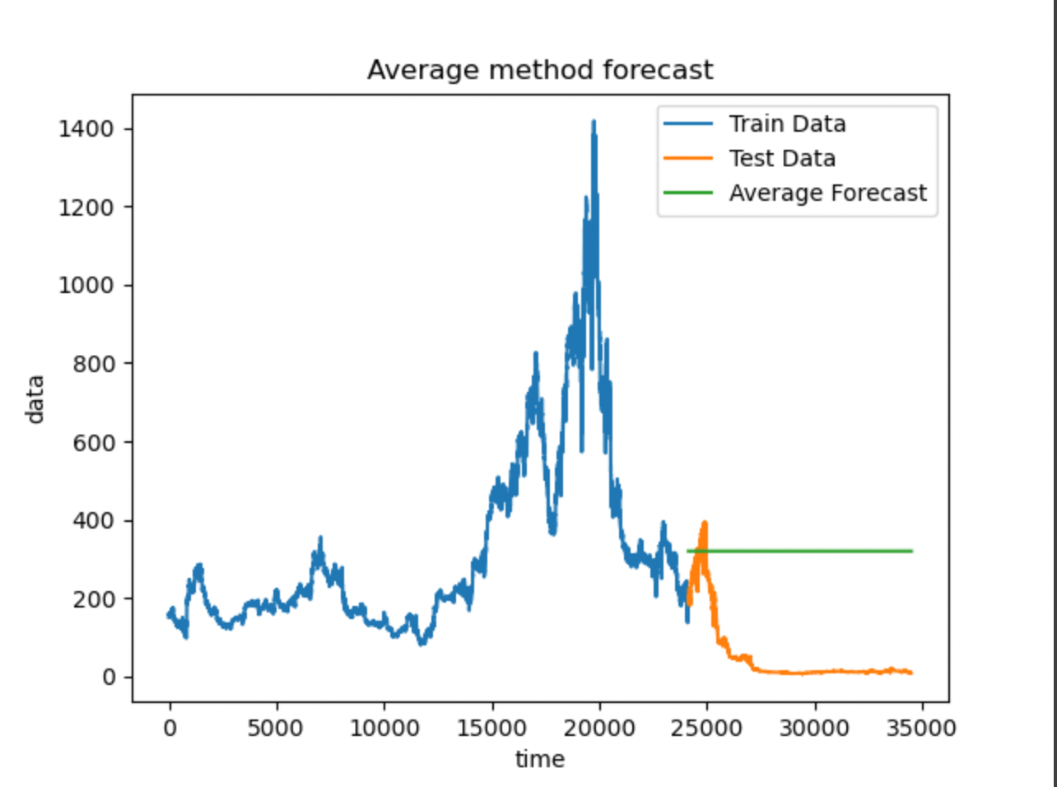
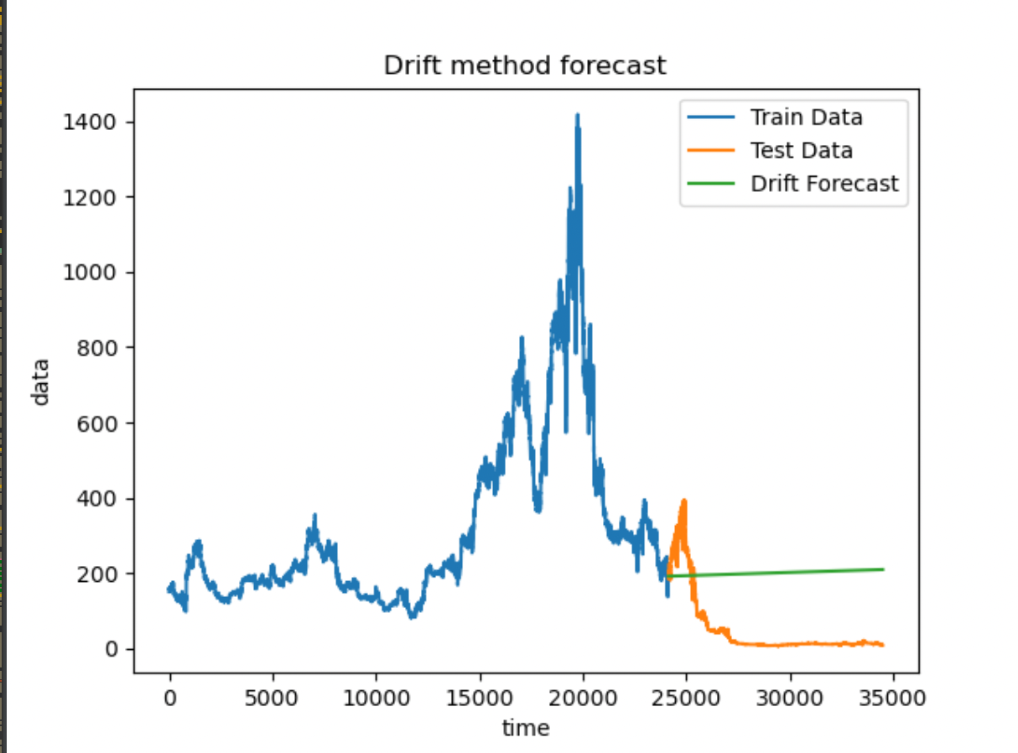
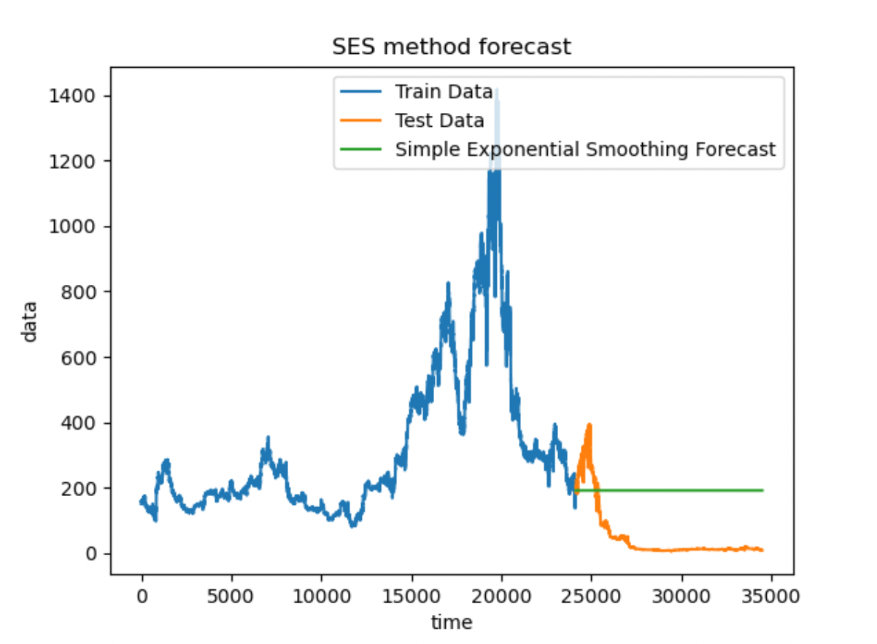
Base-Models:

Slide 13
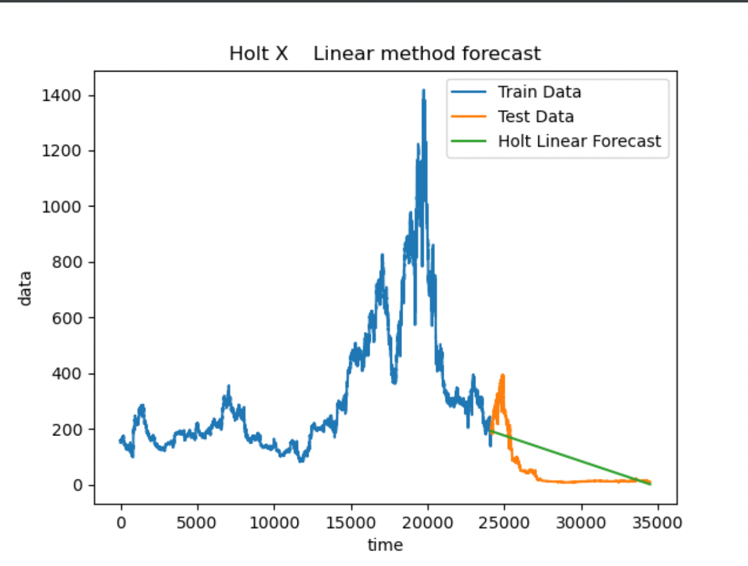
Base-Model (Best Prediction)

Slide 14
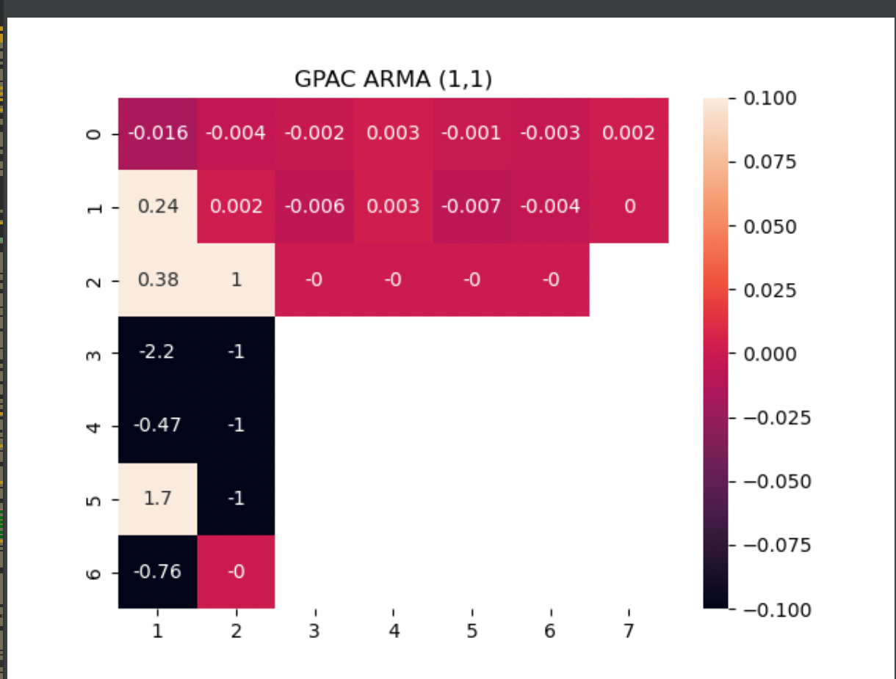
GPAC table
From the GPAC table, na=3, nb=1
2nd set, na=0, nb=3

Slide 15
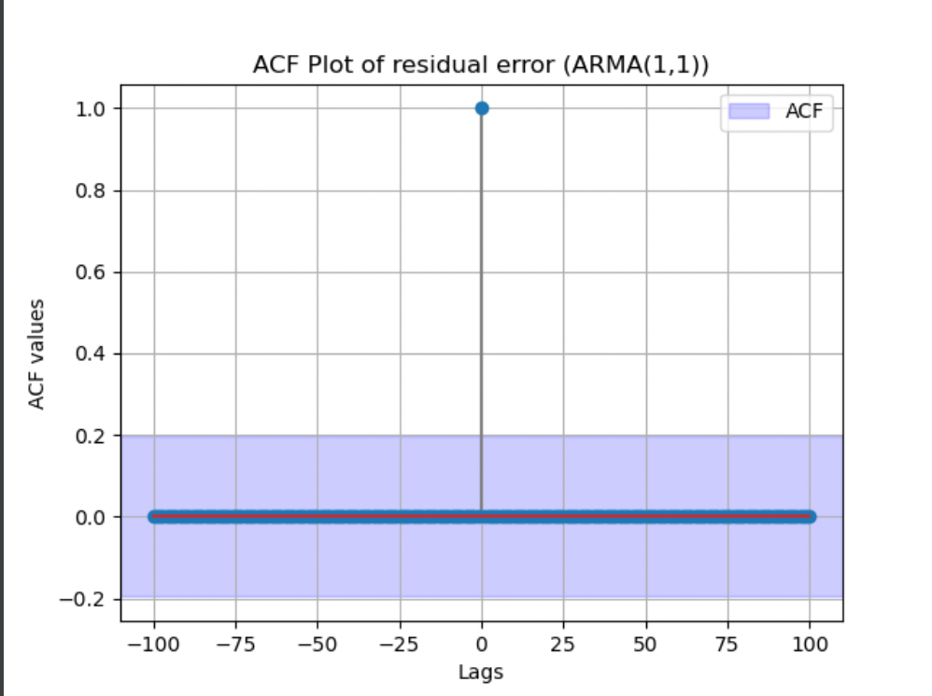
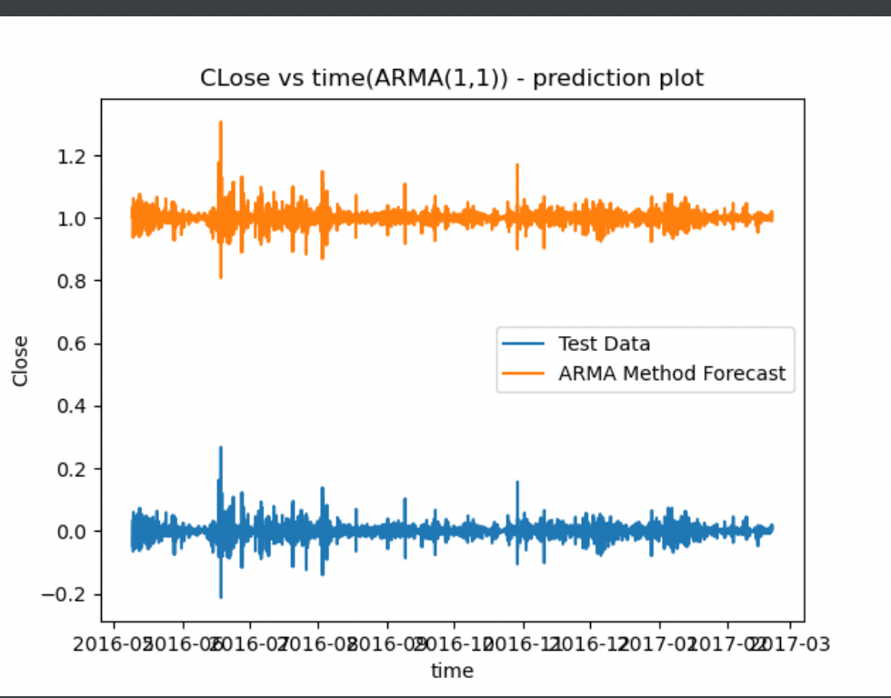
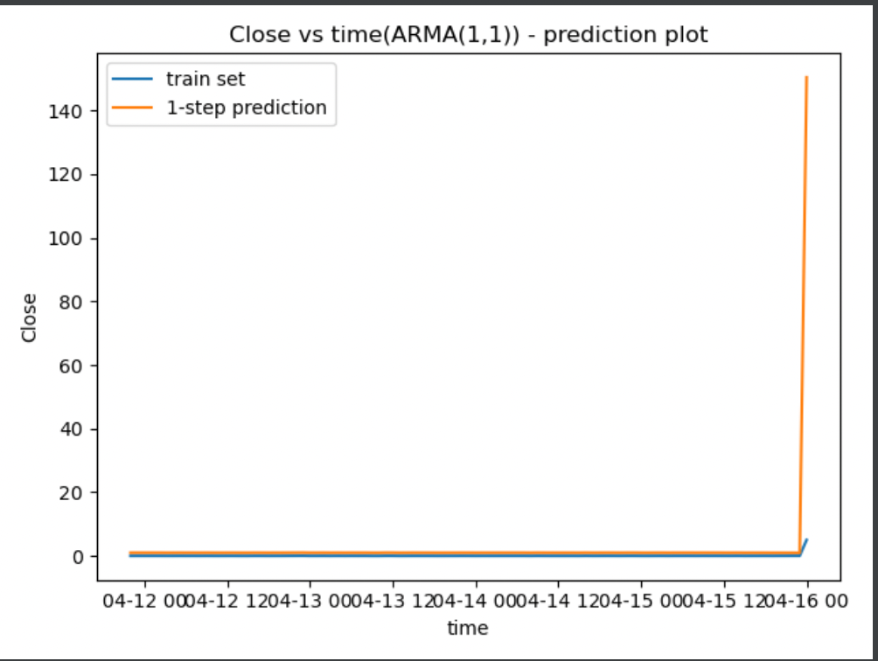
ARMA (1,1)
The AR Coefficient : a1 is:, 7.7971753492885212
The MA Coefficient : b1 is:, 0.755961300211727
confidence intervals of estimated parameters: 0 1
ar.L1 0.434724 1.073694
ma.L1 -1.083625 -0.449376
Chi Squared test results:
The residuals is white, chi squared value :2.5749919487075363e-09
variance of residual error : 0.7554447231482881
variance of forecast error : 0.0006132498037137332

Slide 16
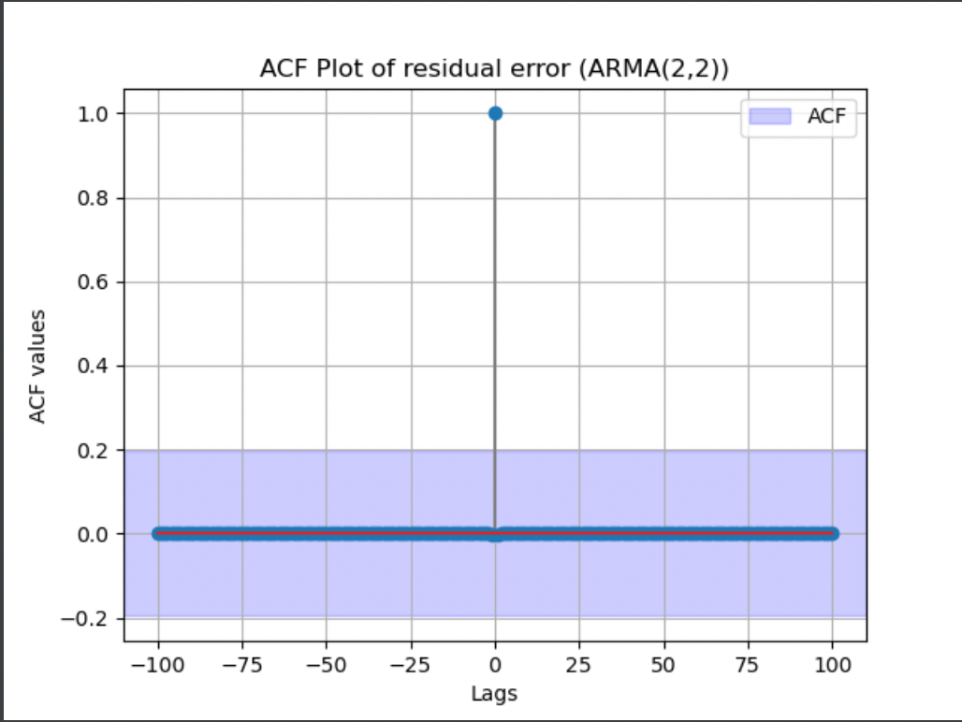
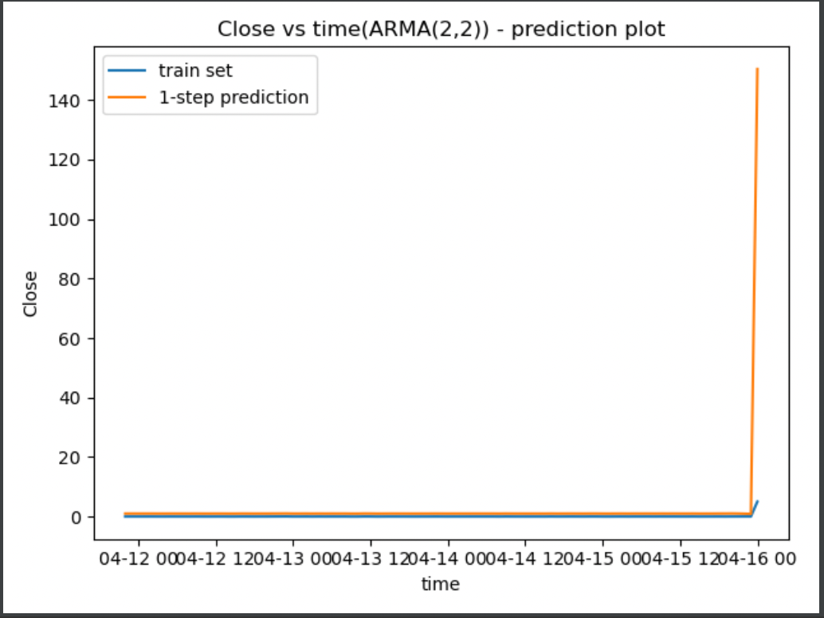
ARMA(2,2)
The AR Coefficient : a1 is:, 8.195856264119555e-05 The AR Coefficient : a2 is:, 0.7904231422672403 The MA Coefficient : b1 is:, -0.40103370405770855 The MA Coefficient : b2 is:, -0.8155494920475628
Chi Squared test results
The residuals is white, chi squared value :5.779291945732471e-10
variance of residual error : 0.755451362874238
variance of forecast error : 3.9080038750518717

Slide 17
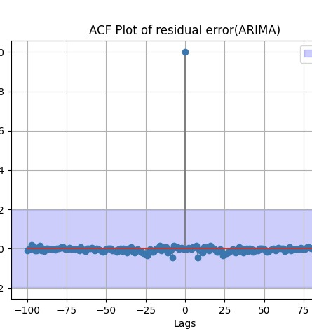
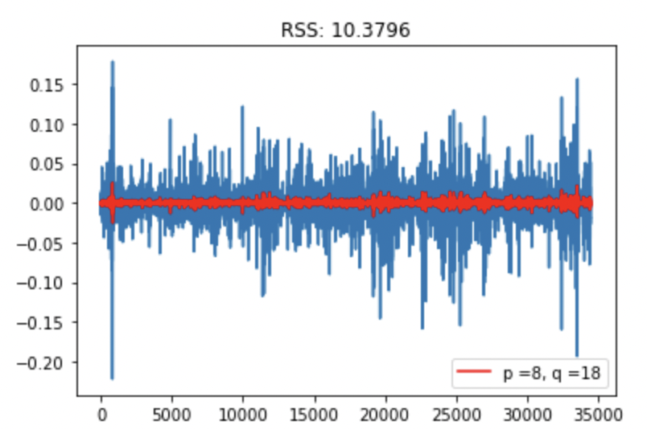
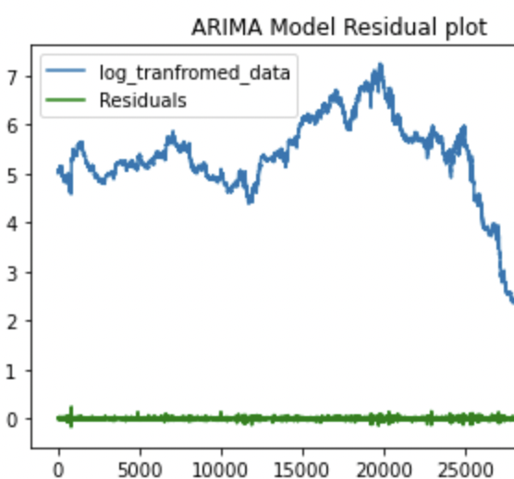
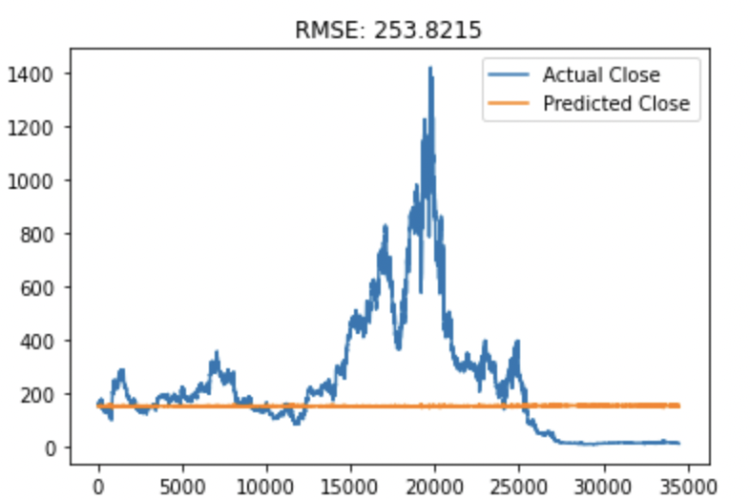
ARIMA(3,1,18)
The AR Coefficient : a1 is:, -0.003177624943659035
The MA Coefficient : b1 is:, 0.7171760560169066
Chi Squared test results
The residuals is white, chi squared value :2.8506147859063486
confidence intervals of estimated parameters: 0 1
const -0.151148 0.144793
ar.L1.D. 0.690452 0.743900
ma.L1.D -0.606795 -0.544399
MSE: 25741.871
variance of forecast error : 13220.248652586179

Slide 18
Summary and conclusion
We found out that 1st order differenced data is stationary, the raw data is non-stationary
We built the ARMA (1,1), ARMA(2,2) ,ARIMA (3,1,18) and ARIMA(2,2,10) models and compared the results of the prediction and forecast and found out that the ARIMA(3,1,18) model is the best model as it has the lowest variance of residual error and variance of forecast error.
We did not perform SARIMA model as we found from the time series decomposition that our dataset did not have much seasonality.

Slide 19
References:
https://www.kaggle.com/prasoonkottarathil/ethereum-historical-dataset?select=ETH_1H.csv Class lecture videos and lecture material Labs and assignment code

Slide 20

Thank you

